Slide 1


Slide 2
What is Nagios
Nagios is the most popular, open source, powerful monitoring system for any kind of infrastructure. It enables organizations to identify and resolve IT infrastructure problems before they affect critical business processes. Nagios has the capability of monitoring application, services, entire IT infrastructure.

Slide 3
Why Nagios
Open source
Relatively scalable, Manageable, Secure and more
Good log and database system
Nice, informative and attractive web interface
Very flexible
Alerts automatically sent if condition changes
Various notification options (Email, pager, mobile phone)‏

Slide 4
What Can it Do?
Individual node status
Is it up?
What is its load?
What is the memory and swap usage?
NFS and network load?
Are the partitions full?
Are applications and services running properly?
How about ping latency?
Aggregated node status
many more

Slide 5
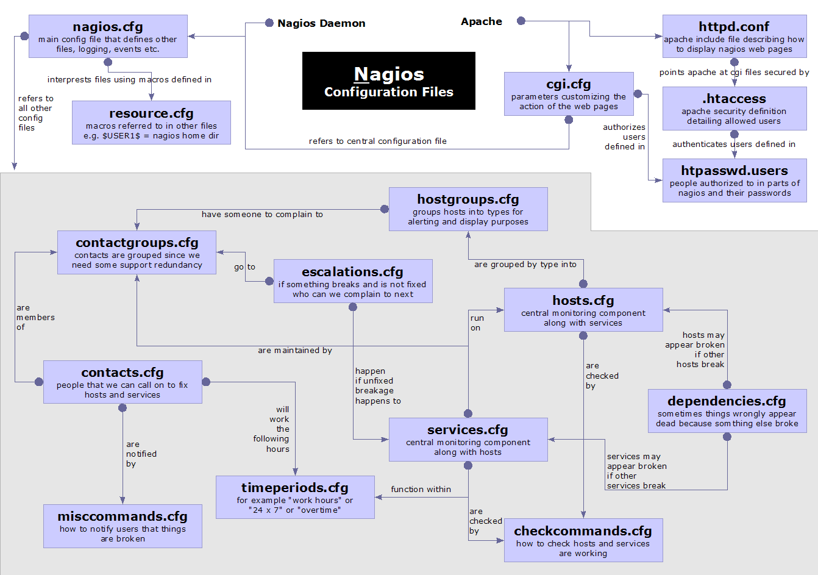

Slide 6
What is nrpe ?
NRPE allows you to remotely execute Nagios plugins on other Linux/Unix machines. This allows you to monitor remote machine metrics (disk usage, CPU load, etc.). NRPE can also communicate with some of the Windows agent addons, so you can execute scripts and check metrics on remote Windows machines as well.

Slide 7
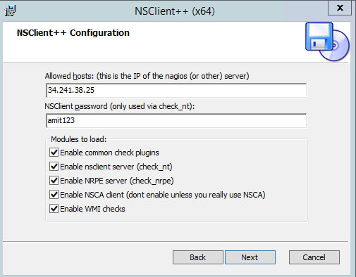
Install NSClient++ Agent on the Remote Windows Host

Slide 8
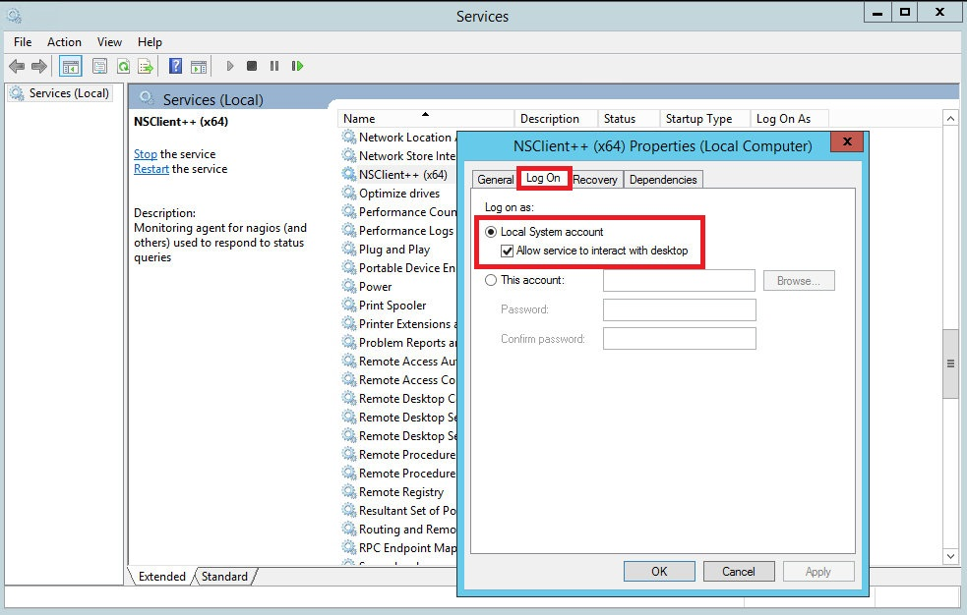
Open the Windows Services Manager and right click on NSClient go to Properties and then ‘Log On‘ tab and click the check box that says “Allow service to interact with the desktop“.

Slide 9
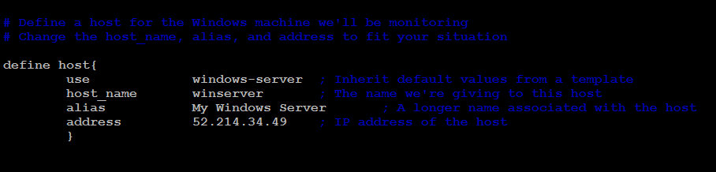
Define Windows host
root@nagios-server:~# vim /usr/local/nagios/etc/objects/windows.cfg

Slide 10
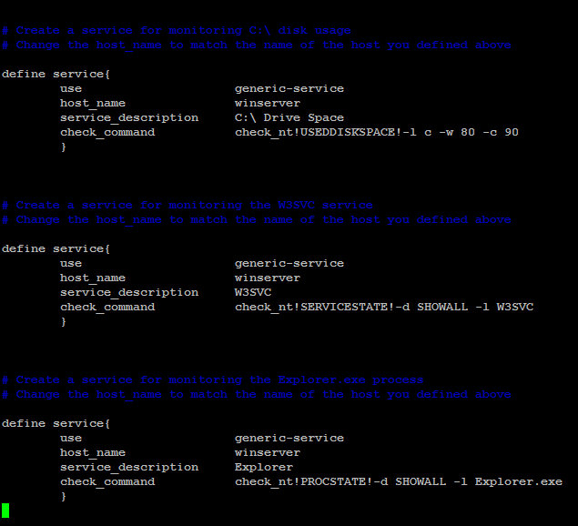
Define Windows Services

Slide 11
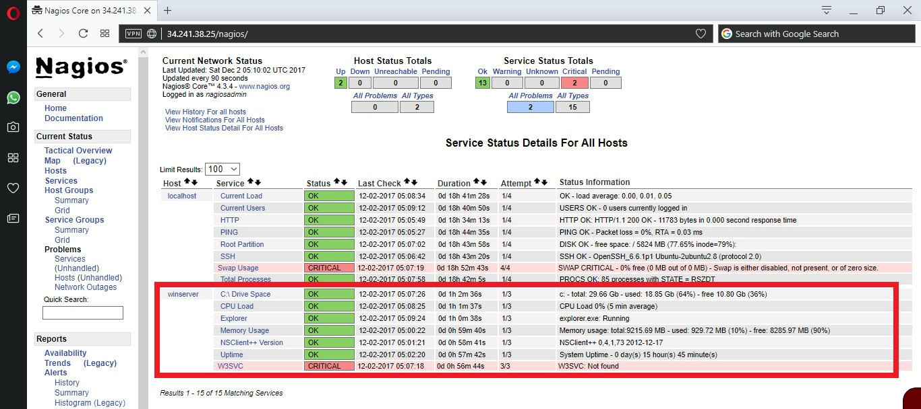

Slide 12
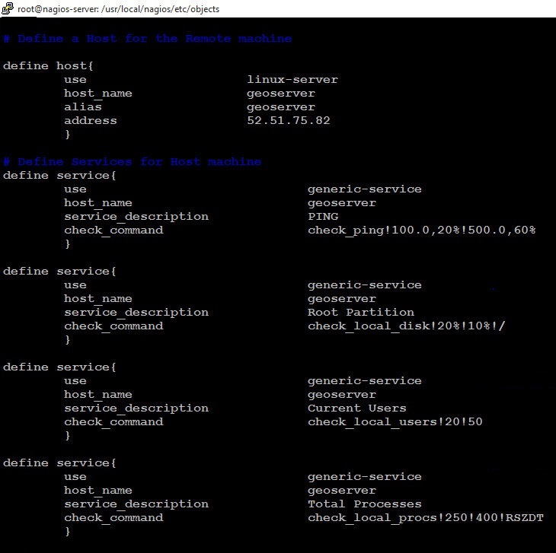
Define Unix host and Services

Slide 13
